Slide 1


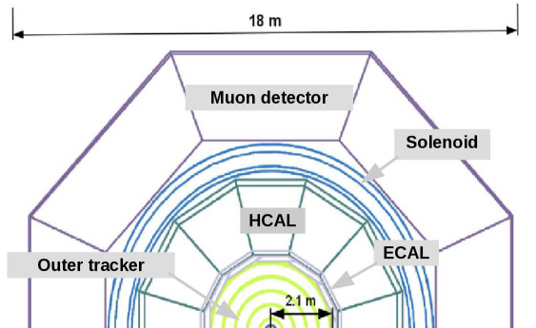
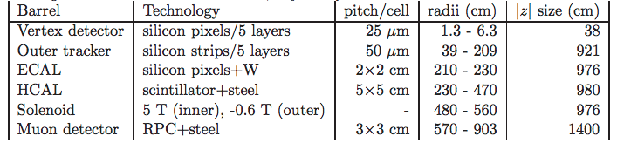
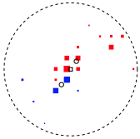
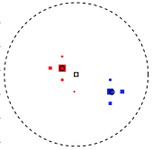

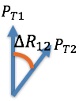
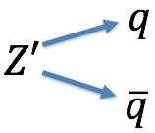
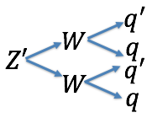
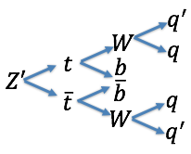
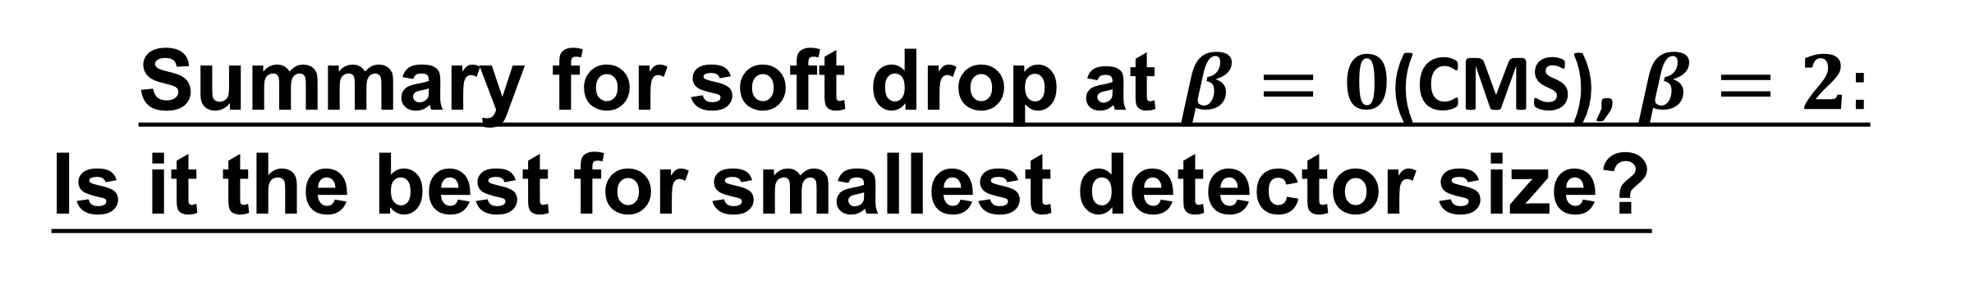
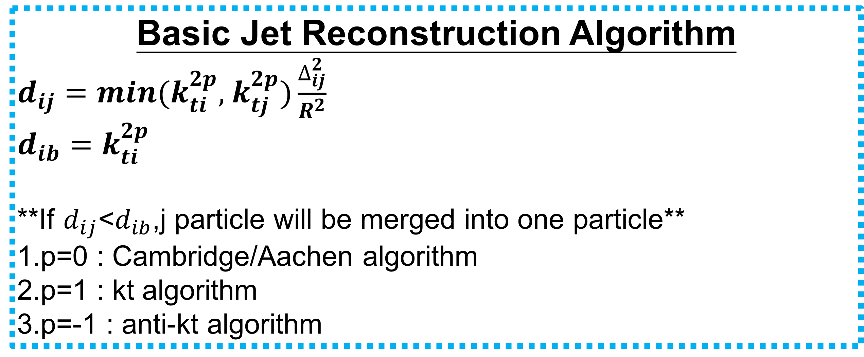




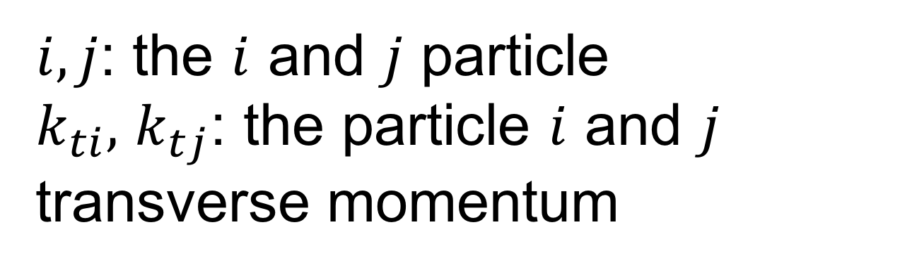

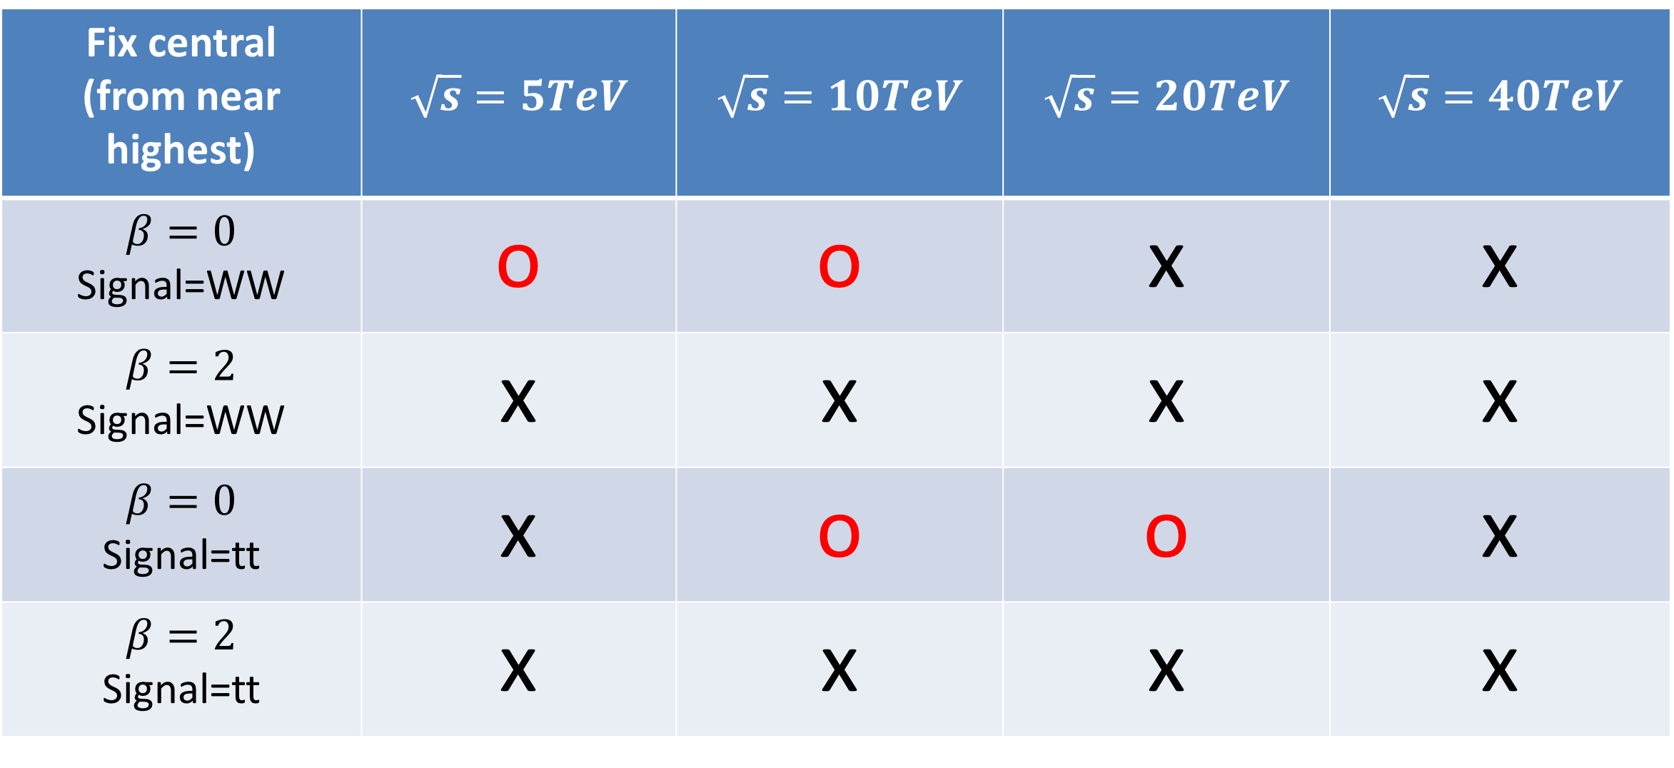


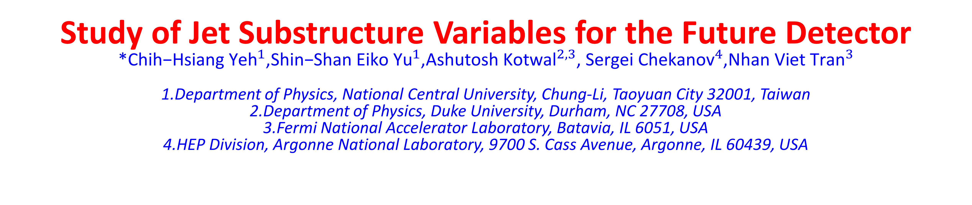

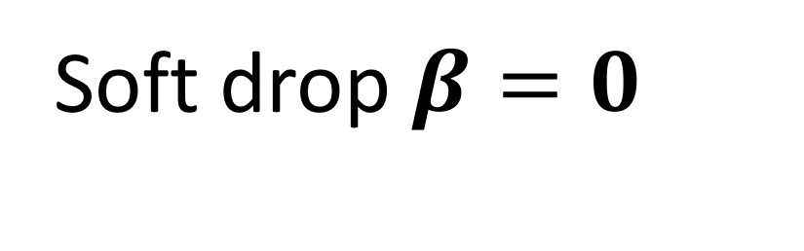
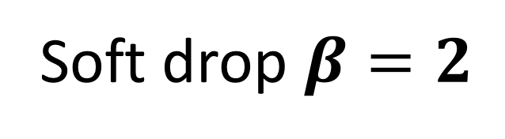
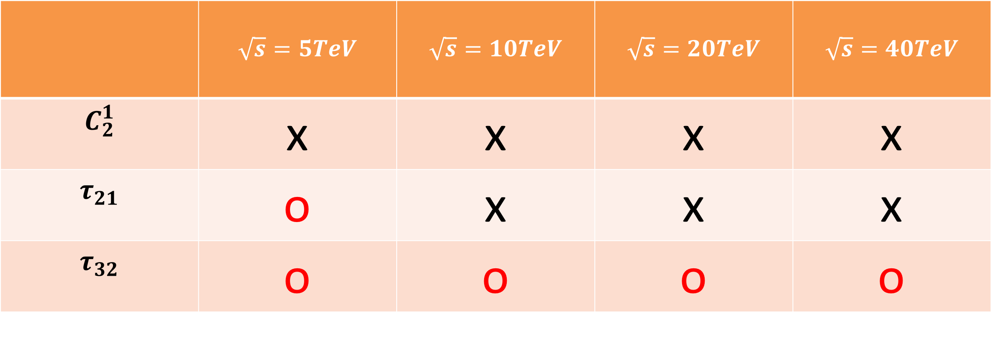
Study of Jet Substructure Variables for the Future Detector
*${\text{Chih}\text{−}\text{Hsiang} \text{Yeh}}^{1}$,${\text{Shin}\text{−}\text{Shan} \text{Eiko} \text{Yu}}^{1}$,${\text{Ashutosh} \text{Kotwal}}^{2,3}$, ${\text{Sergei} \text{Chekanov}}^{4}$,${\text{Nhan} \text{Viet} \text{Tran}}^{3}$
1.Department of Physics, National Central University, Chung-Li, Taoyuan City 32001, Taiwan
2.Department of Physics, Duke University, Durham, NC 27708, USA 3.Fermi National Accelerator Laboratory, Batavia, IL 6051, USA 4.HEP Division, Argonne National Laboratory, 9700 S. Cass Avenue, Argonne, IL 60439, USA
Abstract:
In this poster, we study the performance of hadron calorimeter in SiFCC for the future √s=100 TeV pp collider. The GEANT4 full simulation includes calorimeters with different cell sizes. We aim to efficiently separate signal Z’->ww or Z’->tt and background Z’->qq. Various jet substructure variables and Z’ masses from 5 to 40 TeV are also compared.
Geant 4 Simulation of Future Detector SiFCC
Variables Study in $C_{2}^{1}$,$τ_{21}$,$τ_{32}$:
Distribution of Z’->WW, Z’->qq and Z’->tt, Z’->qq :
$$C_{2}^{(1)}$$
$$τ_{21}$$
$$τ_{32}$$
Comparison of different detector sizes:
Summary for $C_{2}^{1}$, $τ_{21}$, $τ_{32}$:
Is it the best for smallest detector size?
1. For $C_{2}^{1}$, the ROC curves of the three detector cell sizes are close to each other for each collision energy . Therefore, this variable is not sensitive to the detector cell size.
2. For $τ_{21}$, at 5 TeV, the smallest detector size can separate the background from the signal well. However, this is not the usual case as the ROC curves nearly merge together at higher collision energy.
3. For $τ_{32}$, the smallest detector size has the best separation power for all collision energies.
 | $$\sqrt{s}=5TeV$$ | $$\sqrt{s}=10TeV$$ | $$\sqrt{s}=20TeV$$ | $$\sqrt{s}=40TeV$$
$$C_{2}^{1}$$ | x | x | x | x
$$τ_{21}$$ | o | x | x | x
$$τ_{32}$$ | o | o | o | o
Basic Jet Reconstruction Algorithm
$d_{ij}=min(k_{ti}^{2p},$ $k_{tj}^{2p})\frac{∆_{ij}^{2}}{R^{2}}$
$$d_{ib}=k_{ti}^{2p}$$
**If $d_{ij}$<$d_{ib}$,j particle will be merged into one particle**
1.p=0 : Cambridge/Aachen algorithm
2.p=1 : kt algorithm
3.p=-1 : anti-kt algorithm
$$∆_{ij}^{2}=({y_{i}−y_{j})}^{2}+{(∅_{i}−∅_{j})}^{2}$$
$i,j$: the $i$ and $j$ particle
$k_{ti},$ $k_{tj}$: the particle $i$ and $j$ transverse momentum
Study of Soft Drop at $β=0($CMS), $β=2$:
Soft drop $β=0$
Soft drop $β=2$
Jet Substructure Variables
1.N-subjetness:
$τ_{N}=\frac{1}{d_{0}}\sum_{k}{P_{t,k} min\{∆R_{1,k},∆R_{2,k}…∆R_{N,k}\}}$
${ d}_{0}=\sum_{k}{P_{t,k}R_{0}}$
$∆R_{i,k}:The distance between constuient in the eta−phi plane$
$R_{0}:The cone size we want to cluster$
$τ_{21}=\frac{τ_{2}}{τ_{1}},$ $τ_{32}=\frac{τ_{3}}{τ_{2}}$
2.Energy correlation function:
$$ECF\left(N,β\right)=\sum_{i_{1}<i_{2}<..<i_{N}∈J}{(\prod_{a=1}^{N}{PT_{ia}){(\prod_{b=1}^{N−1}{\prod_{c=b+1}^{N}{∆R_{ibic}}})}^{β}}}$$
$C_{N}^{(β)}≡$ $\frac{ECF\left(N+1,β\right)ECF(N−1,β)}{{ECF(N,β)}^{2}}$
3.Soft drop:
$$\frac{min(P_{T1,}P_{T2})}{P_{T1}+P_{T2}}<Z_{cut}{(\frac{∆R_{12}}{R_{0}})}^{β}$$
$$β>0:Remove \left(soft\right), maintain\left(soft−collinar\right)$$
$$β=0:Depend on the cut to select the asymmetry$$
$$β<0:Remove both \left(soft\right)and (collinear)$$
Comparison of different detector size:
Summary for soft drop at $β=0$(CMS), $β=2:$
Is it the best for smallest detector size?
Fix central (from near highest) | $$\sqrt{s}=5TeV$$ | $$\sqrt{s}=10TeV$$ | $$\sqrt{s}=20TeV$$ | $$\sqrt{s}=40TeV$$
$$β=0$$ Signal=WW | o | o | x | x
$$β=2$$ Signal=WW | x | x | x | x
$$β=0$$ Signal=tt | x | o | o | x
$$β=2$$ Signal=tt | x | x | x | x
Signal and Background Process:
Background:
Signal:
Reference
Initial performance studies of a general-purpose detector for multi-TeV physics at a 100 TeV pp collider JINST 12 (2017) P06009

